Slide 1
NoSQL

Slide 2
What’s wrong with SQL?
Single node
Scale vertically
Low availability

Slide 3
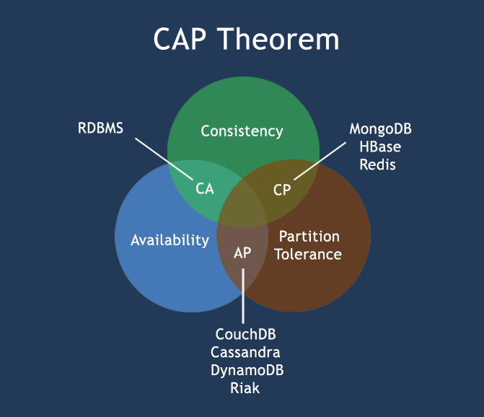

Slide 4
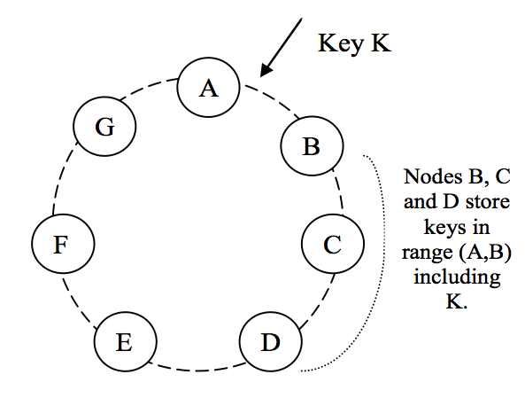
Amazon Dynamo
(N, R, W)

Slide 5
NoSQL benefits and trade-offs
Benefits:
Scales out, not up
Runs on commodity hardware
Fast and consistent at scale
Predictable read/write times
High availability (always-on, applies to Dynamo and Cosmos)
Unstructured schema, stored data in the way the application uses it
Trade-offs:
No SQL
Data denormalization
No joins (unless handles by application)
No ACID compliant
Eventual consistency
Object versioning, possible diversion (Dynamo)
Operational burden (often hundreds of instances)
Hot keys (example: elections db with candidate as a partitioning key)

Slide 6
MongoDB
Open source, paid support is available
Favors consistency over availability
Shell is a full JavaScript interpreter
Support indexes
Built-in aggregation capabilities
A SQL connector is available (but not really designed for joins and normalized data)
Certain limitations (uneven number of servers, single master, multiple secondary servers)

